Slide 1
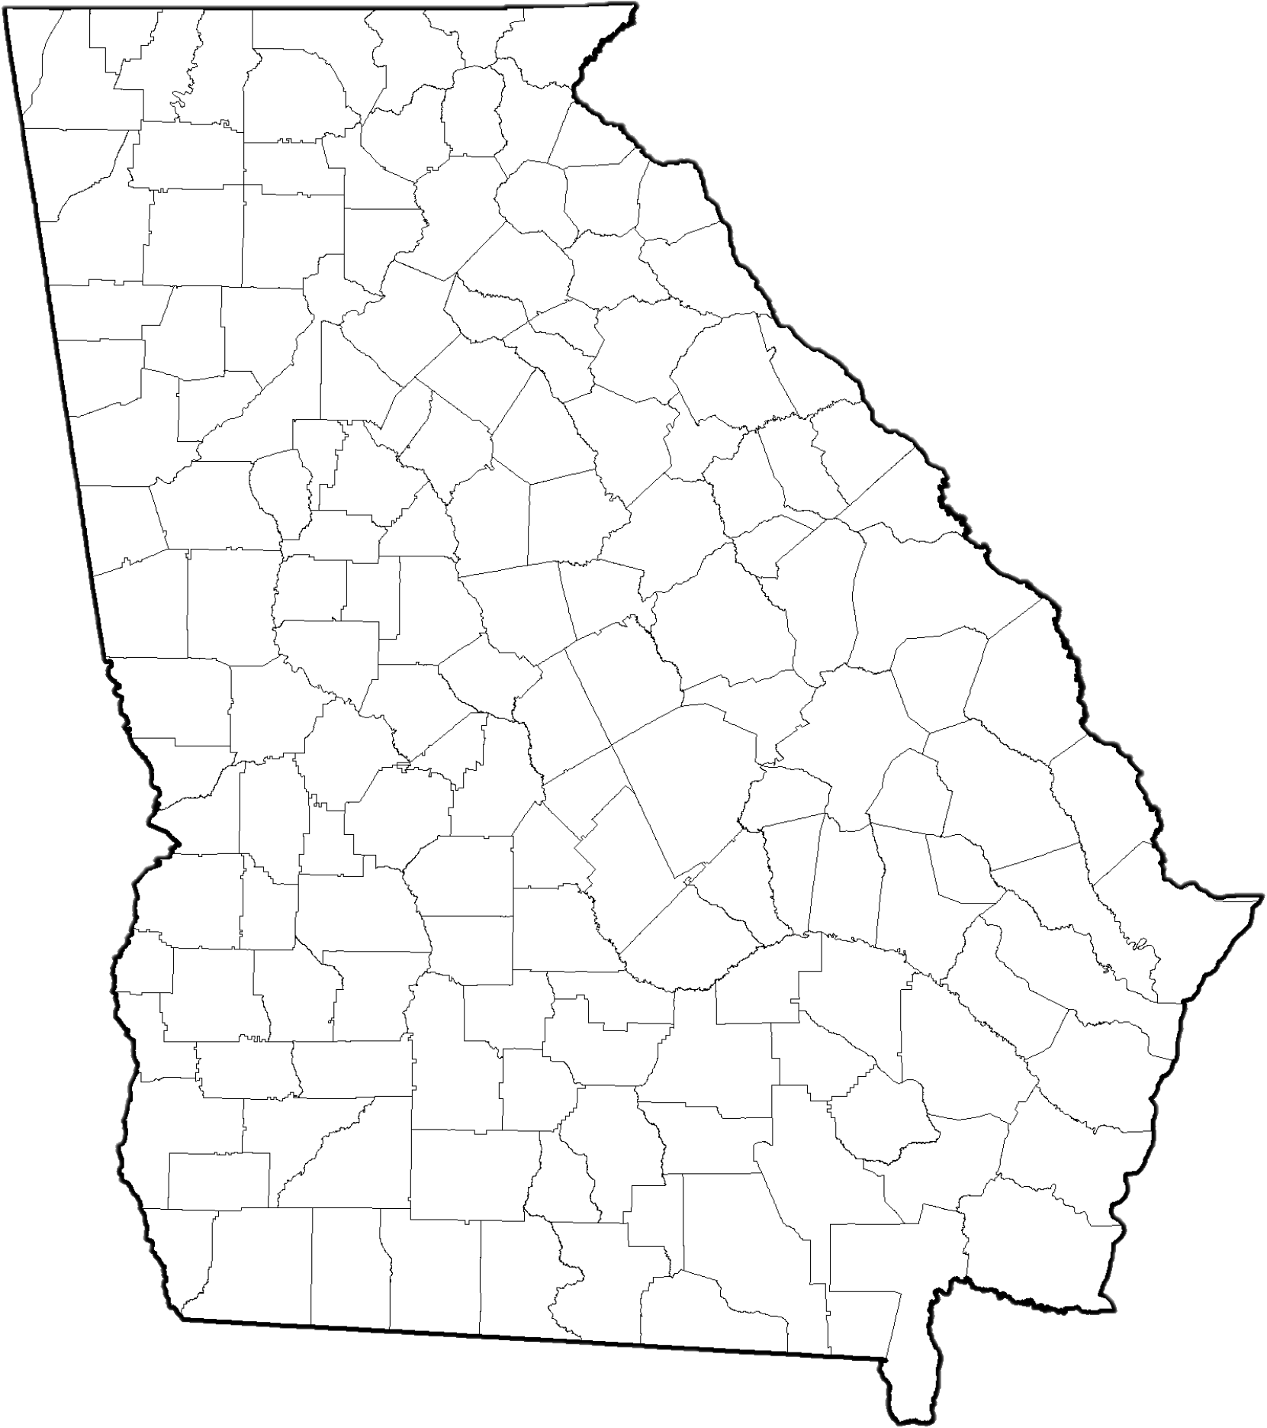


Map My Water
Georgia’s geology and geography determine a lot about your local water resources.
Indicate the following on your map:
The county you live in
The fall line
The major river basin you live in
What is upstream (major cities, other river basins, etc)? What is downstream? Why does this matter?
The area of the state where surface
water is used most for water supply
The area of the state where groundwater is used most for water supply
Name the source of your drinking water
Name your water planning region
When was the last time your region had a major drought?

